Slide 1


Slide 2
Chapter 7
USER INPUT AND WHILE LOOPS
Brief Summary of Chapter 7
In Chapter 7, we will learn how to use while loops in different ways. You’ll see how to ask users for input and store their answers, move items between lists, and remove unwanted items from lists. We’ll also work with dictionaries to collect and store information. You will learn how to control when a loop stops using special commands like break and continue. We will also focus on making sure loops don’t run forever by understanding how to avoid infinite loops.

Slide 3
Understanding User Input and Working with Numbers:
The input() function in Python allows you to get user input as a string. If you need to work with numbers, you can use the int() function to convert the input string into an integer. The modulo operator (%) is useful for finding the remainder when one number is divided by another, such as checking if a number is even or odd by using number % 2 == 0. A prompt, which is a message displayed to guide the user on what kind of input is expected. A clear prompt helps the user understand the task, like asking for a name or age.

Slide 4
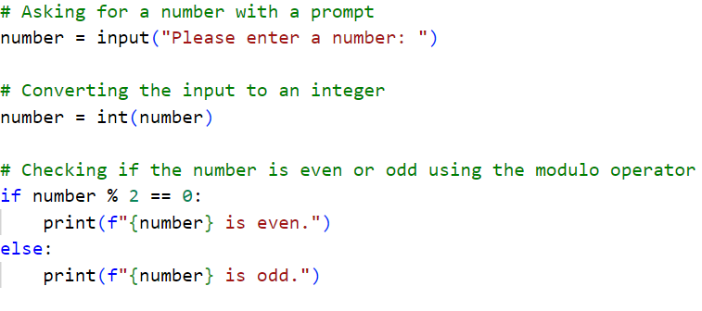

Slide 5
Introducing while Loops
A while loop in Python repeatedly executes a block of code as long as a given condition is true. It’s commonly used when the number of iterations is not known in advance, such as when asking a user for input until they type 'quit' to stop. A flag, a boolean variable that determines whether the loop continues to run, can be used. It is typically set to True at the start and changed to False when certain conditions are met. When the flag is False, the loop will stop, providing better control over the flow of the program.
The break statement allows you to exit a while loop early when a specific condition is met, while continue skips the current iteration and moves to the next one. Infinite loops occur when the loop’s condition never becomes false, often due to missing or incorrect updates to the condition. If your while loop condition is based on a variable (e.g., x), you must update it in each iteration so the loop can eventually stop. This is typically done by incrementing or decrementing the variable (e.g., x += 1 or x -= 1), depending on the logic of your program.

Slide 6
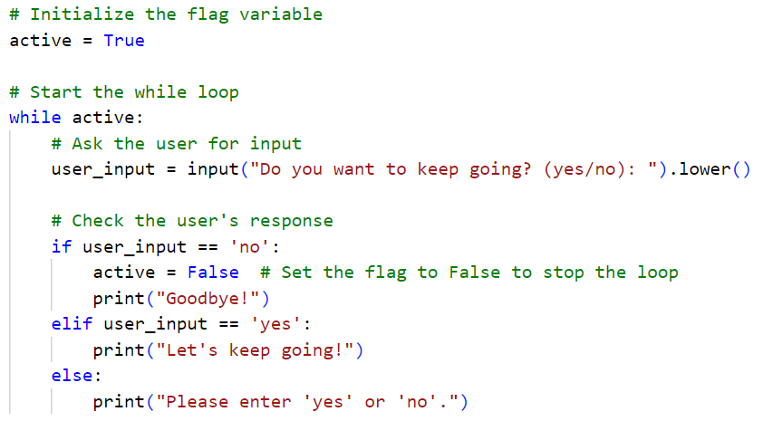
The code uses a while loop that allows the user to decide when to quit by typing 'no'. It also uses a flag (active) to control the flow of the loop. Additionally, the code avoids an infinite loop by ensuring that the loop will stop when the flag is set to False.

Slide 7
Using a while Loop with Lists and Dictionaries
Using a while loop with lists and dictionaries, For the first code we move users from an "unconfirmed" list to a "confirmed" list, verifying and printing each user’s name before adding them to the confirmed list, then displays the confirmed users.
As for the second code we will be removing all instances of the value 'cat' from the "pets" list. It repeatedly checks if 'cat' is in the list and removes the first occurrence of 'cat' each time, until no 'cat' remains, then prints the updated list.
And the third code collects user input to create a dictionary of poll responses, where each user's name is associated with a mountain they wish to climb. It repeatedly asks for names and mountain choices, storing the responses, and gives the option to continue or stop the poll. Once polling ends, it prints the results of the poll. By the end, you'll understand how to manage and organize data effectively using while loops in Python.

Slide 8
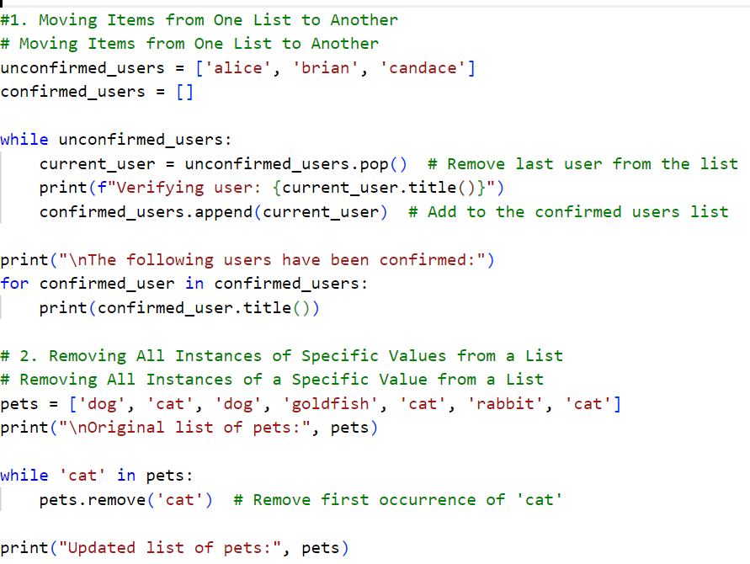

Slide 9
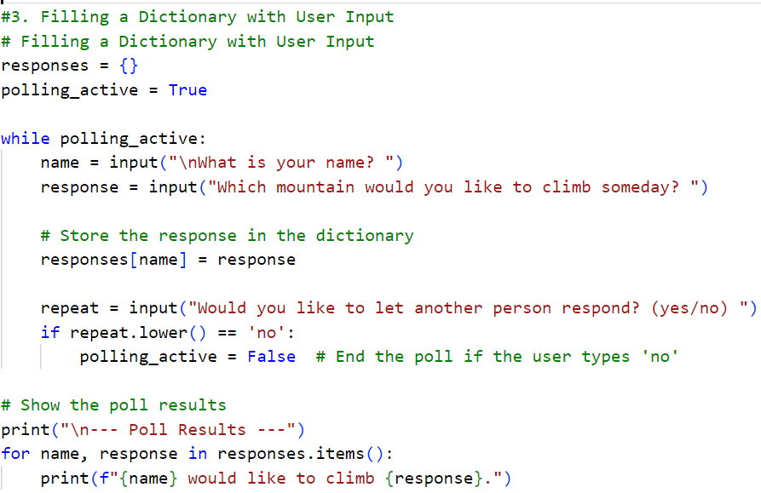

Slide 10
Practice Exercise
Create a Python program that meets the following requirements:
Use a while loop to repeatedly ask the user to enter a number between 1 and 10, or allow them to type "quit" to exit the program.
Add a flag to control when the loop should stop. Set the flag to True initially, and set it to False to exit the loop when the user types "quit" or enters the number 5.
Use the continue statement to skip to the next iteration if the user enters an invalid input (e.g., something that is not a number) or a number outside the range of 1 to 10.
Use the break statement to exit the loop if the user types "quit" or enters the number 5.
If the user types "quit", the loop should end immediately.
If the user enters the number 5, print "You entered 5, exiting the loop" and then stop the loop.
# Use the following to check if the input is a valid number:
if user_input.isdigit():
number = int(user_input)

Slide 11
Practice Exercises
Do the following TRY IT YOURSELF on pages:
117
123
127

Slide 12

End
Of
Chapter 7

